Slide 1









present
Verb
To Be

Slide 2




What is it used for?
To refer to an action or event that takes place habitually, but with the verb "to be" the simple present tense also refers to a present or general state, whether temporary, permanent, or habitual.

Slide 3


example:
I am very excited to learn

Slide 4

The verb to be in the simple present can be also used to refer to something true at the present moment.
"I'm an English teacher."

Slide 5



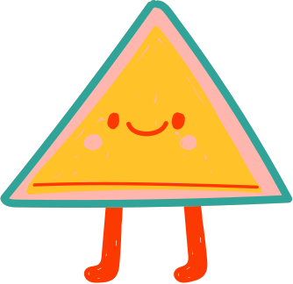
Positive Form
Singular
Plural
I
am
You
are
You
are
We
are
He
is
They
are
She
is
It
is

Slide 6


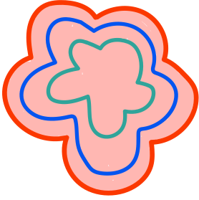
Negative Form
Singular
Plural
I
am not
You
are not
You
are not
We
are not
He
is not
They
are not
She
is not
It
is not

Slide 7



Interrogative Form
Singular
Plural
Am
I
Are
You
Are
You
Are
We
Is
He
Are
They
Is
She
Is
It

Slide 8


Examples
Anna is 10 years old.
Am I invited to your birthday party?.
She is not very happy with the outcome.
My brother is home so we can't be loud.
I bought a new pencil but it is not very nice.
Are they allowed to come?
Is she going to be there for us?

Slide 9


"The blue circle is happy."

Slide 10




Exercises
Create one sentence using the following illustrations and the verb to be.
1
4
7
2
5
8
3
6
9

