Slide 1


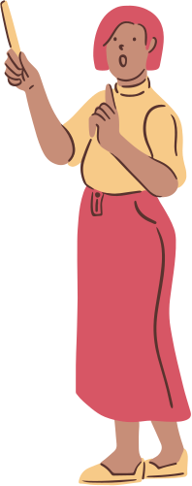
There is
There are

Slide 2

Introduction
Welcome to today's lesson on "There is/There are"
In this lesson, we will learn how to use these phrases to talk about the existence of people, places, or things
Let's get started!

Slide 3
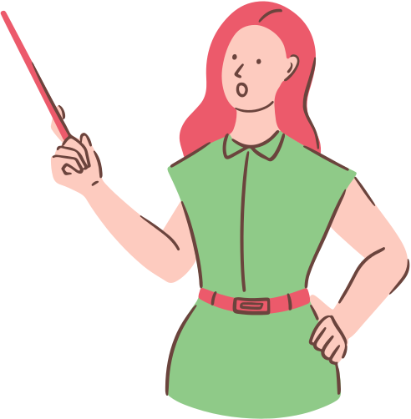
there is
singular
there are
plural

Slide 4
singular
plural
affirmative
There’s a desk
There are five desks
There is a desk
negative
There isn’t a book
There aren´t any books
interrogative
Is there a book?
Yes, there is
No, there isn’t
Are there any pens?
Yes, there are
No, there aren’t

Slide 5

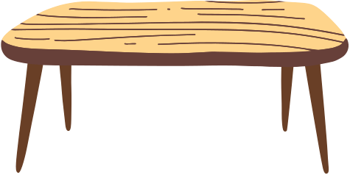
there is
  There is is used when we are talking about the existence of a singular item or person.
  It’s contraction is: there’s
  Example: “There ‘s a computer on the table.”

Slide 6



there are
  There are is used when we are talking about the existence of multiple items or people.
  You cannot contract there are.
  Example: “There are four books on the shelf.”

Slide 7
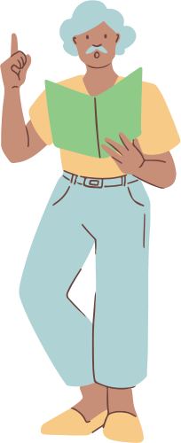
How to Form Affirmative Sentences
To form affirmative sentences with "There is/There are", follow this structure:
There + is/are + noun (singular or plural) + prepositional phrase (optional)
Ex: “There are 30 students on the list.”

Slide 8

How to Form negative Sentences
  To form negative sentences with "There is/There are", follow this structure:
  There + isn't/aren't + noun (singular or plural)
+ prepositional phrase (optional)
Ex: “There aren’t any pencils in the cup.”

Slide 9

How to Form interrogative Sentences
  To form interrogative sentences with "There is/There are", follow this structure:
  Is/Are + there + noun (singular or plural) + prepositional phrase (optional)
  Ex: “Are there any students in the classroom? Yes, there are.”

Slide 10
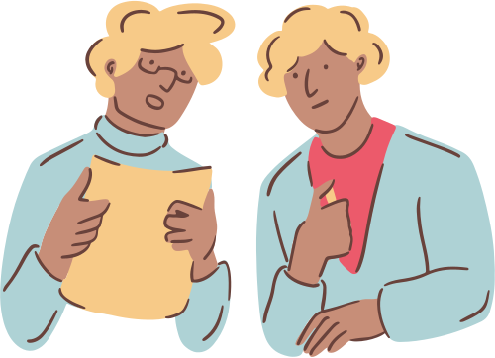
let’s practice!

Slide 11


_________ a pencil in my bag.

Slide 12
there is
_________ a pencil in my bag.

Slide 13

___________ any homework.

Slide 14
there isn’t
___________ any homework.

Slide 15
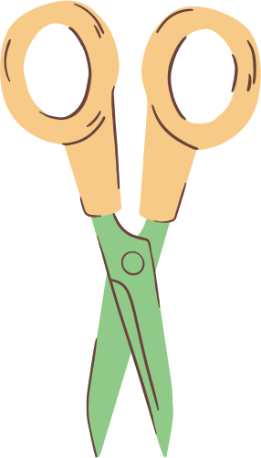
___________ any scissors in your pencilcase?
no, ____________

Slide 16
___________ any scissors in your pencilcase?
no, ____________
are there
there aren’t

Slide 17
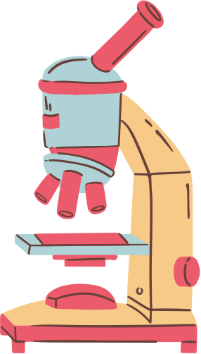
___________ a microscope in the school lab?
yes, ________

Slide 18
___________ a microscope in the school lab?
yes, ________
is there
there is

Slide 19
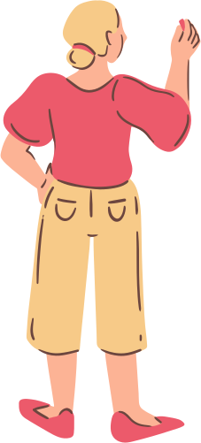

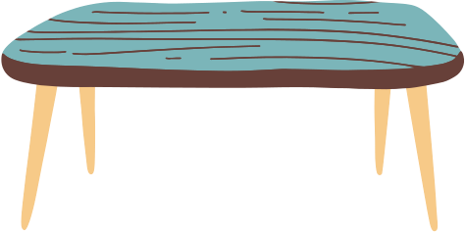
there are
_________ three notebooks on the table .

Slide 20
_________ three notebooks on the table .

Slide 21

Great job!

Slide 22
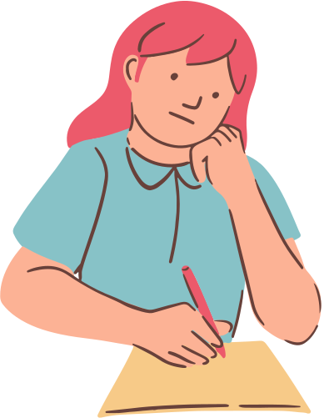
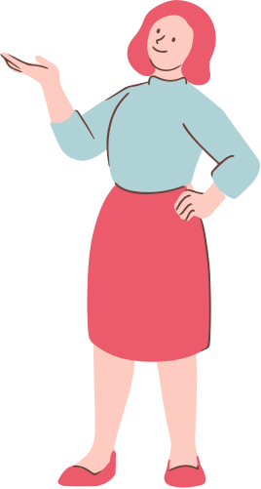
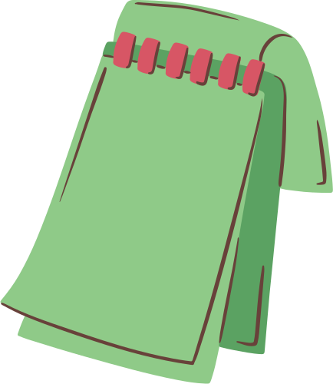
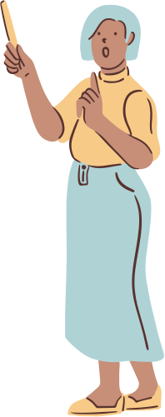
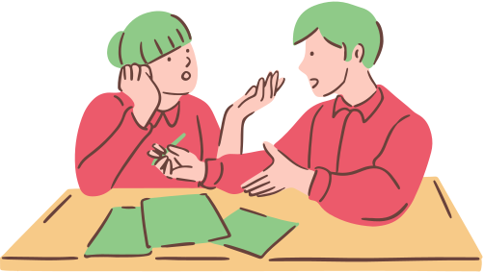

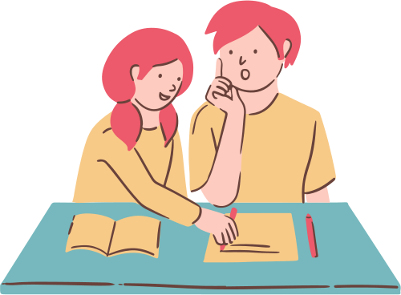




teacher resources page

