Slide 1





PRESENT SIMPLE
tense

Slide 2


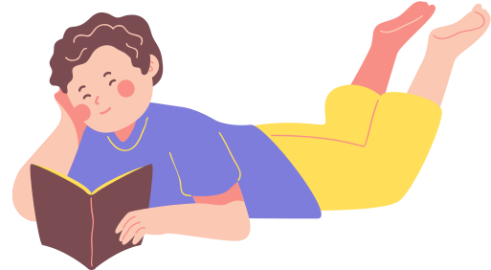





When to use?
We use the Present Simple for routines, facts, and general truths.
EXAMPLES:
I read a book every night.
Water boils at 100 degrees Celsius.
The Earth revolves around the Sun.

Slide 3



How to use?
POSITIVE STRUCTURE:
I
You
We
They
He
She
It
+
eat
+
lunch.
+
eats
+
lunch at school.

Slide 4



Attention!
The verb is used in its base form for the subjects I, You, We, They.
The verb takes an -s, -es, or -ies ending for the subjects He, She, It.
EXAMPLES:
I eat dinner, watch TV, and study Math after school.
He eats dinner, watches TV, and studies Math after school.

Slide 5
How to use?
NEGATIVE STRUCTURE:
I
You
We
They
He
She
It
+
don’t
+
eat
+
doesn’t
+
eat lunch.

Slide 6


Attention!
The subjects I, You, We, They take don’t before the verb.
The subjects He, She, It take doesn’t before the verb.
The subject is always in its base form in negative sentences!
EXAMPLE:
I don’t like broccoli. My sister doesn’t like it either.

Slide 7
How to use?
QUESTION STRUCTURE:
I
you
we
they
he
she
it
Do
+
+
eat
Does
+
+
eat lunch?

Slide 8
Attention!
The subjects I, You, We, They take do before them.
The subjects He, She, It take does before them.
The subject is always in its base form in questions!
EXAMPLES:
Do you speak German?
Does she speak German?

Slide 9
adverbs of
frequency

Slide 10




We usually use the following adverbs of frequency
with the Present Simple Tense:
never
rarely
sometimes
often
usually
always
EXAMPLES:
I never forget to do my homework.
My mum rarely orders pizza.
They often go to the cinema.
I usually play soccer with my dad.
He always studies hard before exams.

Slide 11
THANK YOU
for listening!

